Slide 1







Stack Overflow Developer Survey 2019
Mckinley Petalver
January 3, 2024
https://www.linkedin.com/in/mckinleypetalver/

Slide 2



OUTLINE
Executive Summary
Introduction
Methodology
Results
Visualization – Charts
Dashboard
Discussion
Findings & Implications
Conclusion

Slide 3

EXECUTIVE SUMMARY
Analysis of recent data collected from diverse demographic groups within the technological professional community sheds light on both current and future trends in programming languages, databases, web frameworks, and platforms.
Current Trends:
Dominance of Python, HTML/CSS, and JavaScript in programming languages.
Prevailing use of mySQL, with Windows, Linux and Docker leading in platform choices.
Future Aspirations:
Growing interest in Kotlin and Go for programming languages.
Emerging curiosity in PostgreSQL, MongoDB and Redis for databases and React.js for web frameworks.

Slide 4

INTRODUCTION
Provide actionable insights into developer skills, preferences, and aspirations.
Inform strategic decision-making for talent acquisition, training, technology adoption, and product development.
Explore current data trends using visualizations
Uncover patterns for future trends
Spotlight on respondent demographics for a nuanced perspective.
Age
Gender
Country
Education Level

Slide 5

METHODOLOGY
Data Collection
Web scraping
APIs
Request library
Data Wrangling
Accurate
Complete
Reliable
Timeliness
Relevance
Exploratory Data Analysis
Data distribution
Outliers
Correlations
Data Visualization
Graphs

Slide 6
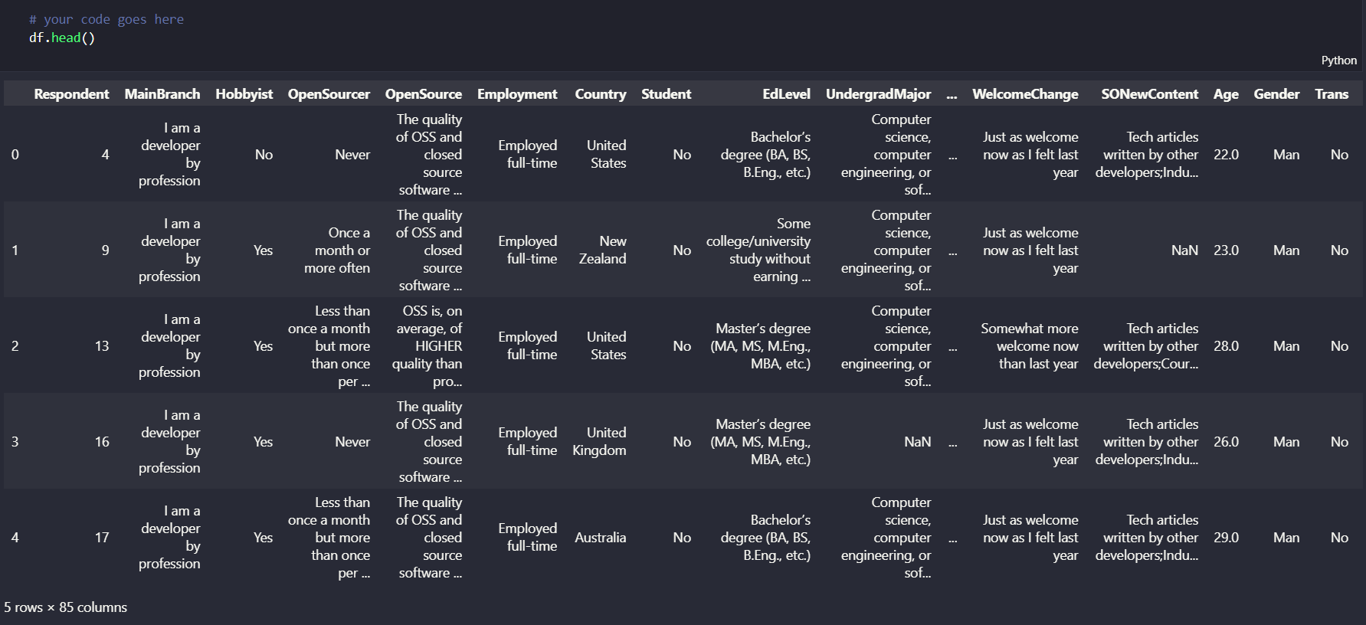

Slide 7
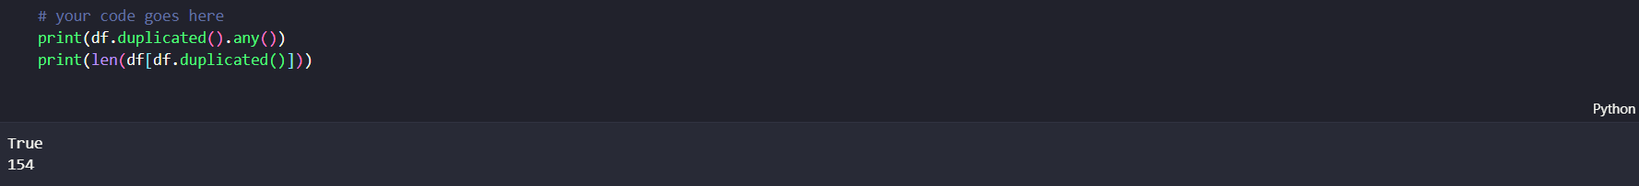
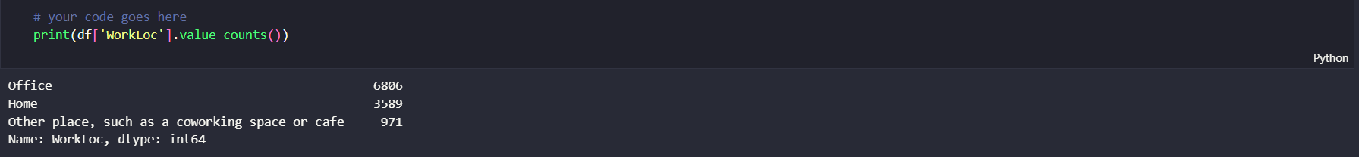
IMPUTATION
DUPLICATES

Slide 8
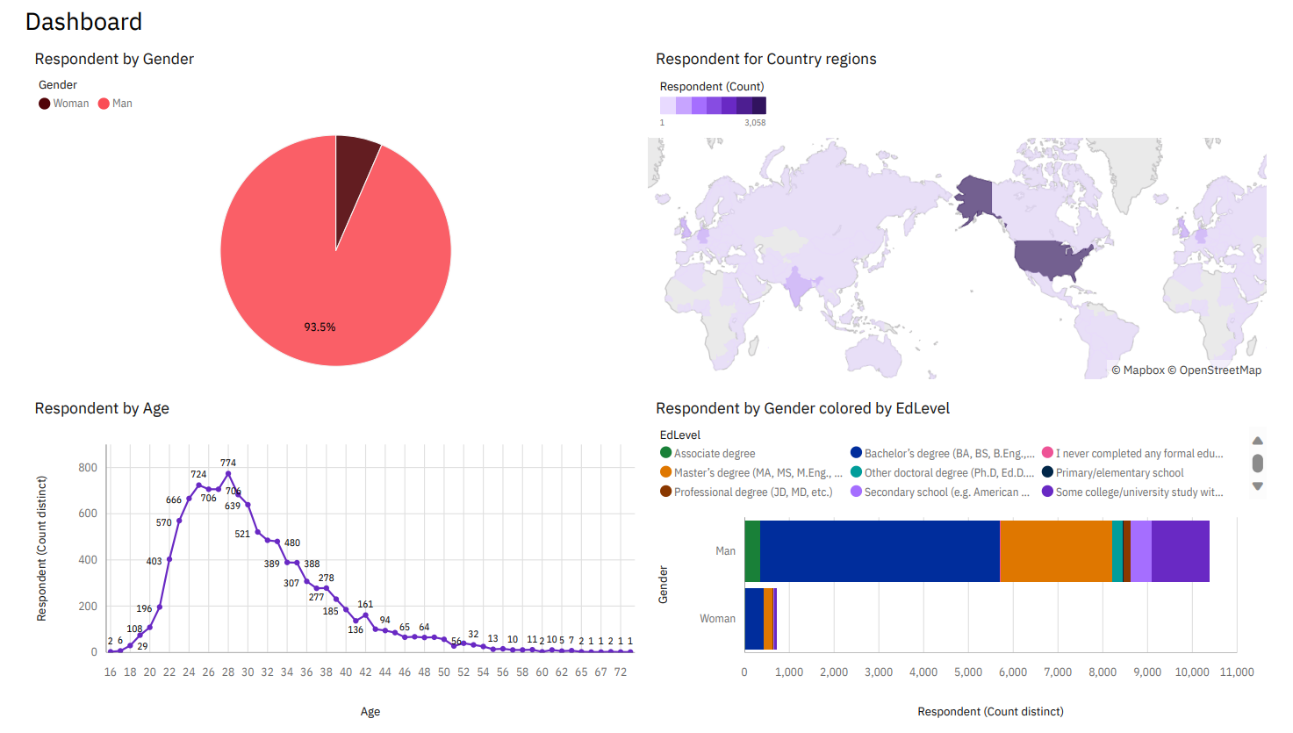
Demographics

Slide 9
RESULTS

Slide 10
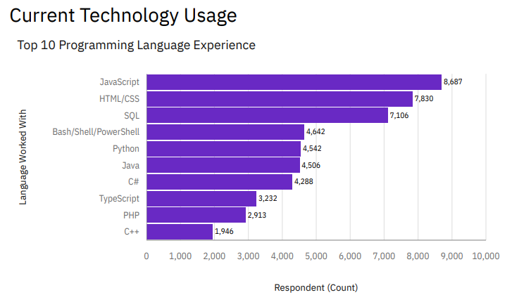
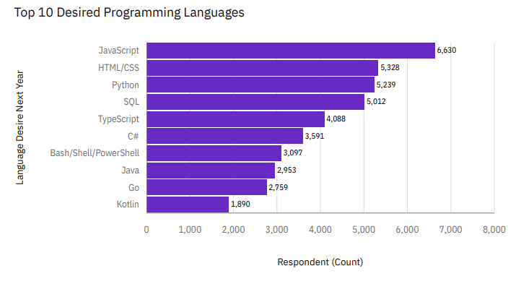
PROGRAMMING LANGUAGE TRENDS
Current Year
Next Year

Slide 11
PROGRAMMING LANGUAGE TRENDS - FINDINGS & IMPLICATIONS
Findings
JavaScript and HTML/CSS maintain their top positions, albeit experiencing a slight decline.
Decline in Java and PHP.
Uprising Kotlin and Go languages
Implications
Programmers shifting to newer languages.

Slide 12
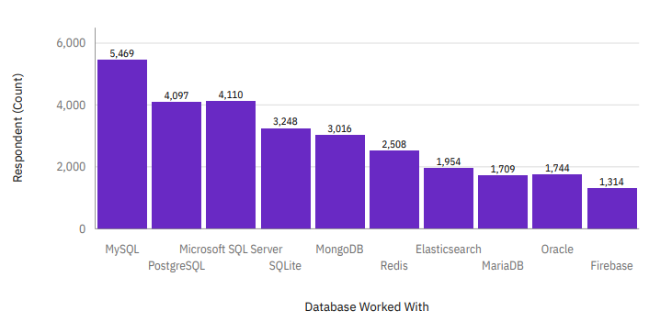
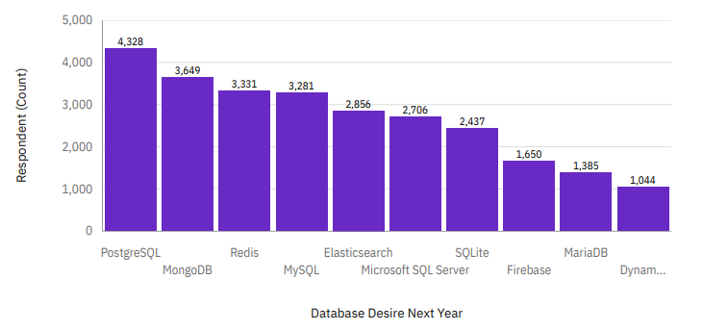
DATABASE TRENDS
Current Year
Next Year

Slide 13
DATABASE TRENDS - FINDINGS & IMPLICATIONS
Findings
Decline in mySQL
Huge rise in PostgreSQL and MongoDB
Slight rise in Redis
Implications
Databases trend shift.
Establishment of PostgreSQL and MongoDB in the market.

Slide 14

DASHBOARD
https://drive.google.com/file/d/1zMRfTnJHQ3IcZ7Eh2bQGuUkyWBNKId7L/view?usp=sharing

Slide 15
DISCUSSION

Slide 16
OVERALL FINDINGS & IMPLICATIONS
Findings
JavaScript and HTML/CSS persist at the forefront but show a slight decline.
MySQL usage sees a decline.
Kotlin, Go and Redis are on the rise.
Implications
Programmers are adapting to newer languages.
Organizations may need to consider the evolving landscape for skill requirements.
Significant shifts in database preferences call for industry adaptation.

Slide 17

CONCLUSION
Dynamic Industry Trends: The findings highlight the industry's adaptability to emerging technologies in both programming languages and databases, creating a dynamic and ever-changing landscape.
Necessity of Adaptation: Professionals and organizations are urged to adapt to evolving trends by embracing newer languages and databases. This adaptation is crucial for maintaining relevance and competitiveness in the continuously evolving tech ecosystem.
Strategic Insights: The identified trends offer valuable insights for strategic decision-making. Individuals and businesses can leverage these insights to align their skills and infrastructure with both current and future demands of the tech industry.

Slide 18






Thank You!
Stack Overflow Developer Survey 2019
Mckinley Petalver

